Slide 1

TOPIC 05 TCP/IP

Slide 2
Objectives
Describe the purpose of a network protocol and the layers in the TCP/IP architecture
Describe TCP/IP Application-layer protocols
Describe TCP/IP Transport-layer protocols
Describe TCP/IP Internetwork-layer protocols
Describe TCP/IP Network access-layer protocols

Slide 3
TCP/IP’s Layered Architecture
Protocols are rules and procedures for communication and behavior
Computers must “speak” the same language and agree on the rules of communication
When a set of protocols works cooperatively it is called a protocol suite (or “protocol stack”)
The most common protocol stack is Transmission Control Protocol/Internet Protocol (TCP/IP)
TCP/IP is composed of more than a dozen protocols operating at different levels of the communication process

Slide 4
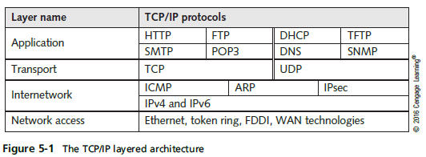
TCP/IP’s Layered Architecture

Slide 5

TCP/IP’s Layered Architecture
Example of how the layers work together:
You start your Web browser and your home page is http://www.cengage.com
The web browser formats a request for your home page by using the Application layer protocol HTTP
The request looks something like:
The unit of information the Application layer works with is simply called “data”

Slide 6

TCP/IP’s Layered Architecture
Example continued:
The Application-layer protocol HTTP passes the request down to the Transport-layer protocol (TCP)
TCP adds a header to the request that looks like:
The unit of information the Transport layer works with is called a segment
TCP passes the segment to the Internetwork layer protocol (IP)

Slide 7

TCP/IP’s Layered Architecture
Example continued:
IP places its header on the segment:
The unit of information is now called a packet
The packet is passed down to the Network access layer, where the NIC operates
A frame header and trailer are added
The frame is delivered to the network medium as bits
on its way to the www.cengage.com server
The web server processes it and returns a Web page

Slide 8
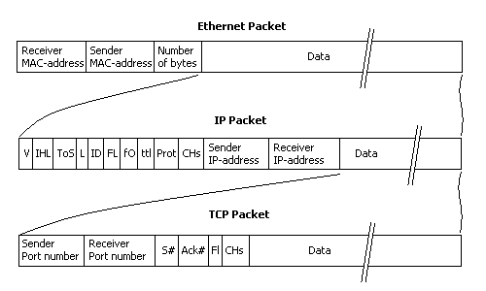
Packet details
The data part of an Ethernet packet can hold up to 1500 bytes. MAC-addresses (48bits) are 6 bytes wide each and the Number Of Bytes field is 2 byte wide. That gives the maximum size of an Ethernet frame to be 1514 bytes( maximum size including FCS is 1518 )

Slide 9
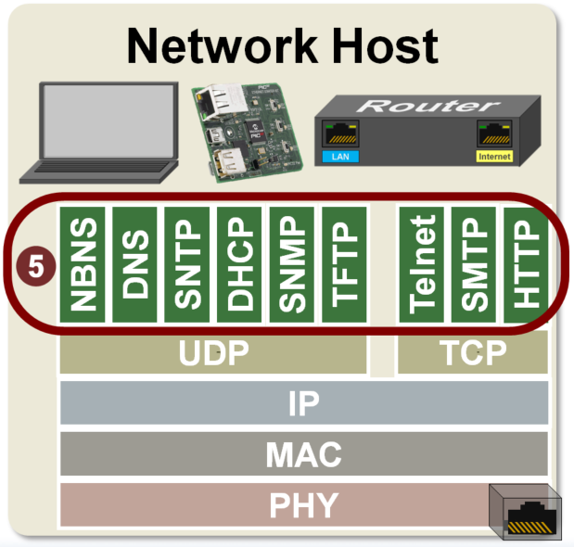
Application Layer

Slide 10
Remote Desktop Protocol
Remote Desktop Protocol (RDP) is used to access a Windows computer remotely by using the Windows GUI
Used to run Windows applications remotely and network administrators use it to manage Windows workstations and servers remotely

Slide 12
Telnet and SSH
Telnet and Secure Shell (SSH)
Used to connect to a device across a network via a command-line interface
Example: use to connect to a managed switch or router
Telnet uses TCP port 23
Is not a secure protocol
SSH uses TCP port 22
Provides an encrypted channel between the client and server

Slide 13
Domain Name System
DNS is a name-to-address resolution protocol that keeps a list of computer names and their IP addresses
Using DNS a user can use a computer’s name instead of using it’s IP address
Example:
When you enter www.cengage.com in your Web browser, the DNS Client service contacts the DNS server specified in your OS’s IP configuration and requests that the name be resolved to an IP address
Once the IP address for the website is returned, your computer can contact Web server to request a Web page
DNS uses UDP because DNS messages usually consist of a single packet of data
DNS Explained

Slide 14

E-Learning

Slide 15
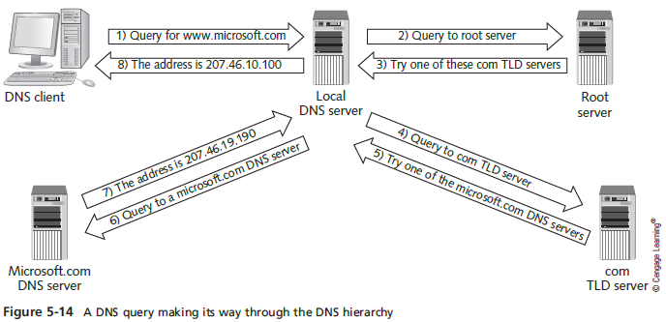
DNS Server

Slide 16
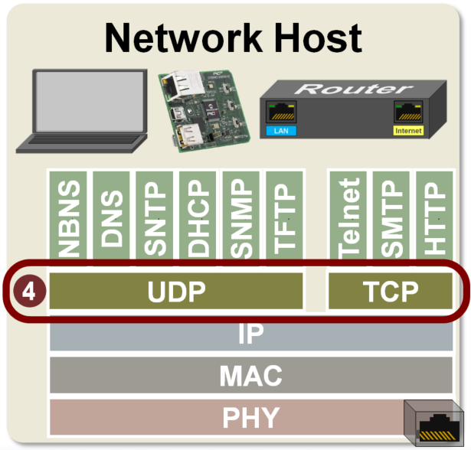
TCP Transport-Layer Protocols
Notes:
Layer 4 is the Transport layer. The transport layer creates virtual Transfer Control Protocol (TCP) or User Datagram Protocol (UDP) connections between network hosts.
This layer sends and receives data to and from the applications running on its host. The Transport layer assigns port numbers to the processes running in applications on the host and adds a TCP or UDP header to the messages received from the applications detailing the source and destination port numbers.
Note that some of the applications, specifically Telnet, SMTP, and HTTP require TCP as the transport protocol while the others use UDP.
https://microchipdeveloper.com/tcpip:tcp-ip-transport-layer-layer-4

Slide 17
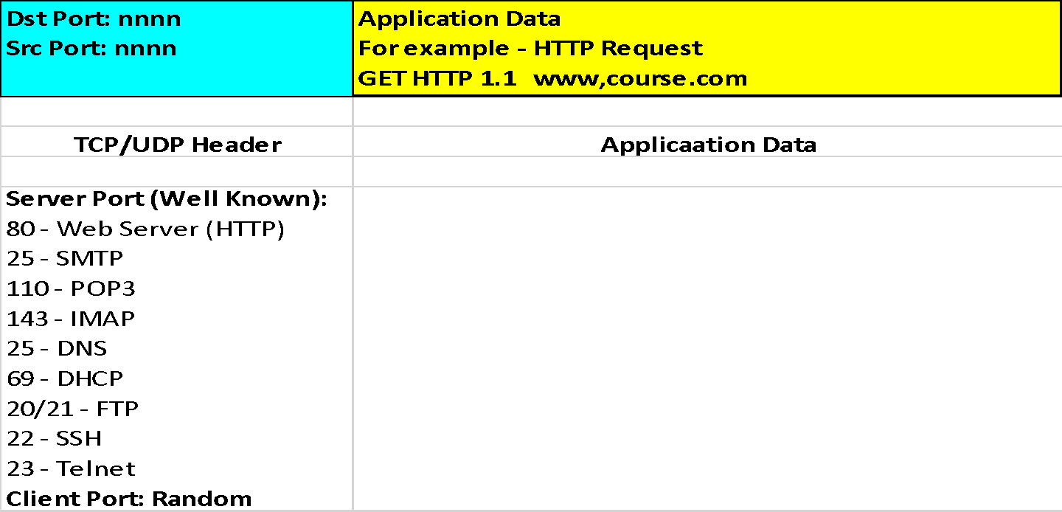
Transport-Layer Protocols
Transport-layer protocols are used with most Application-layer protocols because they:
Supply a header field to identify the Application layer
Provide reliability and flow control for applications that typically transfer a large amount of data
53

Slide 18
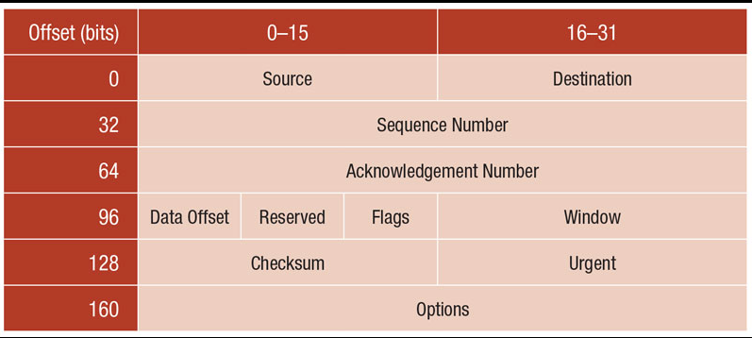
TCP Header
Notes:
TCP Header Format
Each TCP header has ten required fields totaling 20 bytes (160 bits) in size. They can also optionally include an additional data section up to 40 bytes in size.
This is the layout of TCP headers:
Source TCP port number (2 bytes)
Destination TCP port number (2 bytes)
Sequence number (4 bytes)
Acknowledgment number (4 bytes)
TCP data offset (4 bits)
Reserved data (3 bits)
Control flags (up to 9 bits)
Window size (2 bytes)
TCP checksum (2 bytes)
Urgent pointer (2 bytes)
TCP optional data (0-40 bytes)
TCP inserts header fields into the message stream in the order listed above.
Source and destination TCP port numbers are the communication endpoints for sending and receiving devices.
Message senders use sequence numbers to mark the ordering of a group of messages. Both senders and receivers use the acknowledgment numbers field to communicate the sequence numbers of messages that are either recently received or expected to be sent.
The data offset field stores the total size of a TCP header in multiples of four bytes. A header not using the optional TCP field has a data offset of 5 (representing 20 bytes), while a header using the maximum-sized optional field has a data offset of 15 (representing 60 bytes).
Reserved data in TCP headers always has a value of zero. This field serves the purpose of aligning the total header size as a multiple of four bytes (important for the efficiency of computer data processing).
TCP uses a set of six standard and three extended control flags (each an individual bit representing on or off) to manage data flow in specific situations. One bit flag, for example, initiates TCP connection reset logic. The detailed operation of these fields goes beyond the scope of this article.
TCP senders use a number called window size to regulate how much data they send to a receiver before requiring an acknowledgment in return. If the window size becomes too small, network data transfer will be unnecessarily slow, while if the window size becomes too large, the network link can become saturated (unusable for any other applications) or the receiver may not be able to process incoming data quickly enough (also resulting in slow performance). Windowing algorithms built into the protocol dynamically calculate size values and use this field of TCP headers to coordinate changes between senders and receivers.
The checksum value inside a TCP header is generated by the protocol sender as a mathematical technique to help the receiver detect messages that are corrupted or tampered with.
The urgent pointer field is often set to zero and ignored, but in conjunction with one of the control flags, it can be used as a data offset to mark a subset of a message as requiring priority processing.
Usages of optional TCP data go beyond the scope of this article but include support for special acknowledgment and window scaling algorithms.

Slide 19
Role of the Transport Layer
Transport layer has two protocols:
Transmission Control Protocol (TCP)
Connection oriented and designed for reliable transfer of information in complex internetworks
User Datagram Protocol (UDP)
Connectionless and designed for efficient communication of generally small amounts of data
TCP vs UDP
Both:
Work with segments(TCP) or datagrams(UDP)
Provide a means to identify the source and destination applications involved in a communication
Protect data with a checksum

Slide 20
Working with Segments and Datagrams
Transport-layer protocols work with units of data called segments (TCP) or datagrams (UDP)
Both TCP and UDP add a header to data
The Transport-layer protocol then passes the segment to the Internetwork protocol (IP)
With incoming data, the Transport-layer receives the segment from the Internetwork protocol, processes it, de-encapsulates it and sends the resulting data up to the Application layer

Slide 21
Identifying Source and Destination Applications
How do computers keep track of incoming data when a Web browser, email application, chat and a word processing program are all running at the same time?
TCP and UDP use port numbers to specify the source and destination Application-layer protocols
Port numbers are 16-bit values assigned to specific applications running on a computer or network device
Decimal | 80
Binary | 0000 0000 0101 0000
Hex | 50

Slide 22
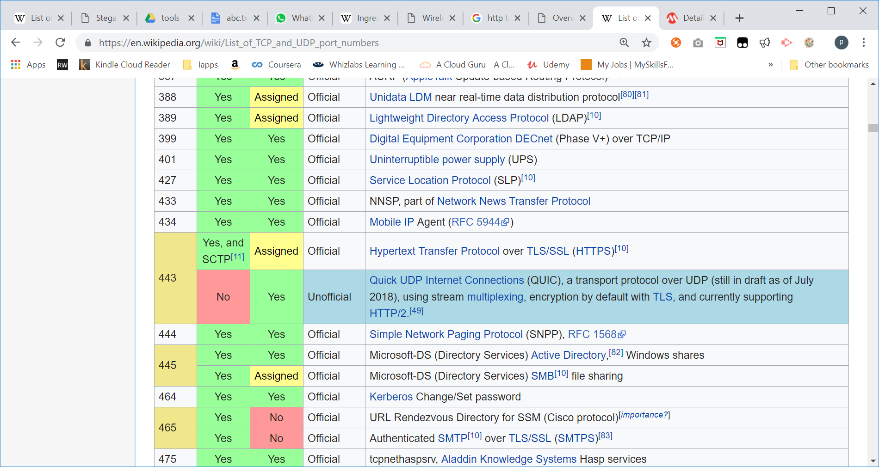
Port number 443
https://en.wikipedia.org/wiki/List_of_TCP_and_UDP_port_numbers
Decimal | 443
Binary | 0000 0001 1011 0001
Hex | 01BB

Slide 23
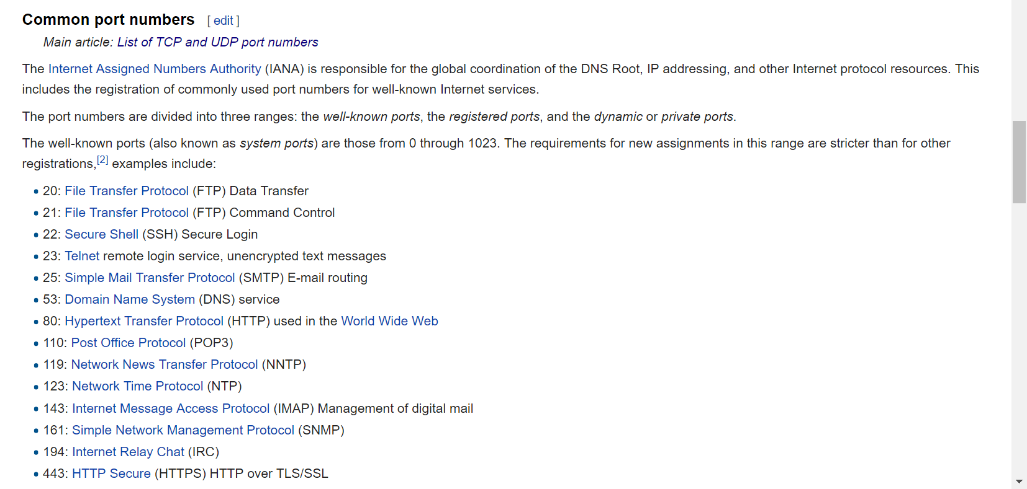
Common port Numbers
Notes:
Network behavior[edit]
Transport layer protocols, such as the Transmission Control Protocol (TCP) and the User Datagram Protocol (UDP), transfer data using protocol data units (PDUs). For TCP, the PDU is a segment, and a datagram for UDP. Both protocols use a header field for recording the source and destination port number. The port numbers are encoded in the transport protocol packet header, and they can be readily interpreted not only by the sending and receiving computers, but also by other components of the networking infrastructure. In particular, firewalls are commonly configured to differentiate between packets based on their source or destination port numbers. Port forwarding is an example application of this.
Examples[edit]
An example for the use of ports is the Internet mail system. A server used for sending and receiving email generally needs two services. The first service is used to transport email to and from other servers. This is accomplished with the Simple Mail Transfer Protocol (SMTP). The SMTP service application usually listens on TCP port 25 for incoming requests. The second service is usually either the Post Office Protocol (POP) or the Internet Message Access Protocol (IMAP) which is used by e-mail client applications on users' personal computers to fetch email messages from the server. The POP service listens on TCP port number 110. Both services may be running on the same host computer, in which case the port number distinguishes the service that was requested by a remote computer, be it a user's computer or another mail server.

Slide 24
Protecting Data with a Checksum
To protect data integrity, TCP and UDP provide a checksum(check errors) similar to the CRC
Intermediate devices don’t recalculate the checksum in the Transport layer so if data corruption occurs during the transmission, the final receiving station detects the checksum error and discards the data

Slide 25
TCP: The Reliable Transport Layer
If an application requires reliable data transfer, it uses TCP as the Transport-layer protocol
How does TCP guarantee data delivery?
TCP provides reliability by using these features:
Establishing a connection
Segmenting large chunks of data
Ensuring flow control with acknowledgements
TCP is a connection-oriented protocol
It establishes a connection with the destination, data is transferred, and the connection is broken

Slide 26
Establishing a Connection: The TCP three-way-Handshake
A client sends a TCP synchronization (SYN) segment to the destination device, usually a server
A destination port is specified and a source port is assigned dynamically
When the server receives the SYN segment, it responds by sending either an acknowledgement-synchronization (ACK-SYN) segment or a reset connection (RST) segment
RST is sent when the server refused the request to open the session
If an ACK-SYN(sent by destination) is returned, the client completes the three-way handshake by sending an ACK segment back to the server

Slide 27
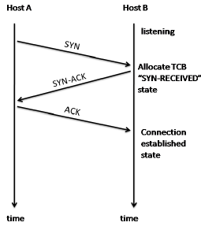
Establishing a Connection: The TCP three-way-Handshake

Slide 28
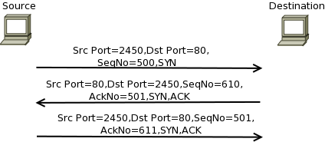
3 Way Hand shake Example
Notes:
the source starts the three-way handshake by sending a TCP header to the destination with the SYN flag set. The destination responds back with the SYN and ACK flag sent. Notice in the figure that destination uses the received sequence number plus 1 as the Acknowledgement number. This is because it is assumed that 1 byte of data was contained in the exchange. In the final step, the source responds back with only the ACK bit set. After this, the data flow can commence.

Slide 29
Establishing a normal TCP connection requires three separate steps:
1. The first host (Alice) sends the second host (Bob) a "synchronize" (SYN) message with its own sequence number which Bob receives.
2. Bob replies with a synchronize-acknowledgment (SYN-ACK) message with its own sequence number and acknowledgement number, which Alice receives.
3. Alice replies with an acknowledgment (ACK) message with acknowledgement number , which Bob receives and to which he doesn't need to reply.

Slide 30
Segmenting Data
When TCP receives data from the Application layer, the size might be too large to send in one piece
TCP breaks the data into smaller segments (max frame sent by Ethernet is 1518 bytes)
Each segment is labeled with a sequence number so that if segments arrive out of order they can be reassembled in the correct order

Slide 31
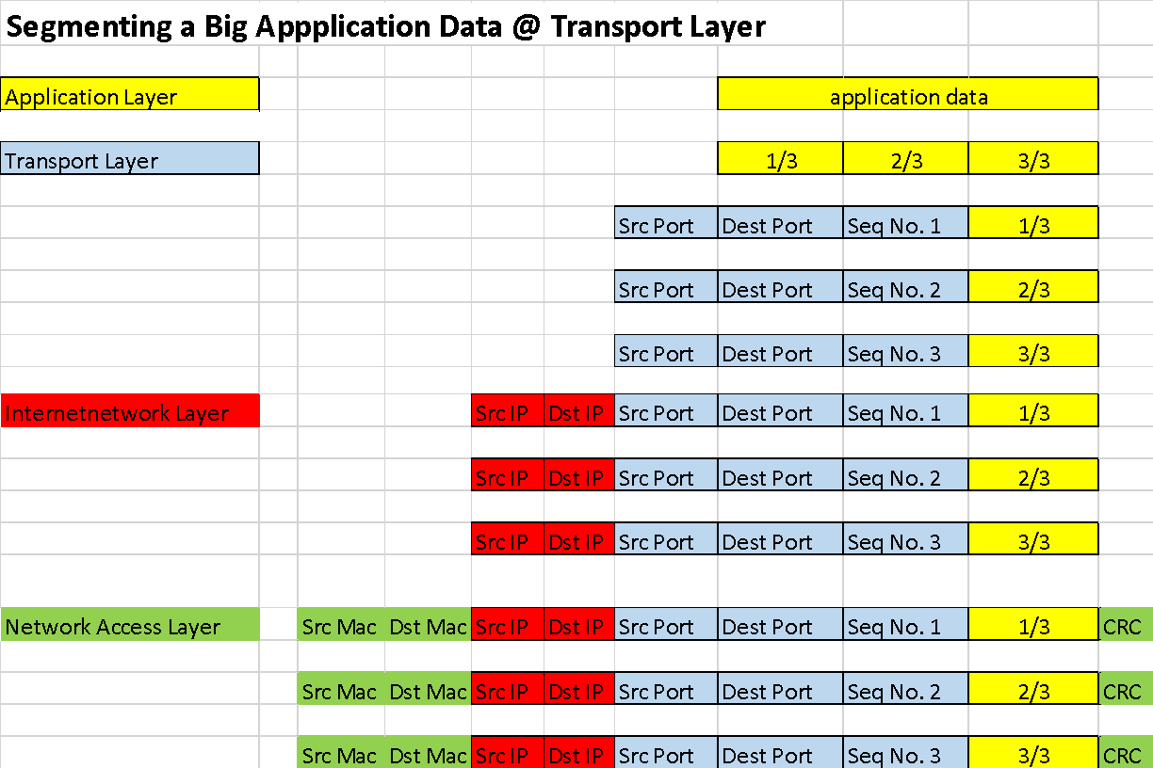
Segmentation

Slide 32
Ensuring Flow Control with Acknowledgements
Flow control prevents a destination from becoming overwhelmed by data, resulting in dropped packets
TCP establishes a maximum number of bytes, called the “window size”, that can be sent before the destination must acknowledge the receipt of data
If no acknowledgement is received within a specified period of time, the sending station will retransmit from the point at which an acknowledgement was last received

Slide 33
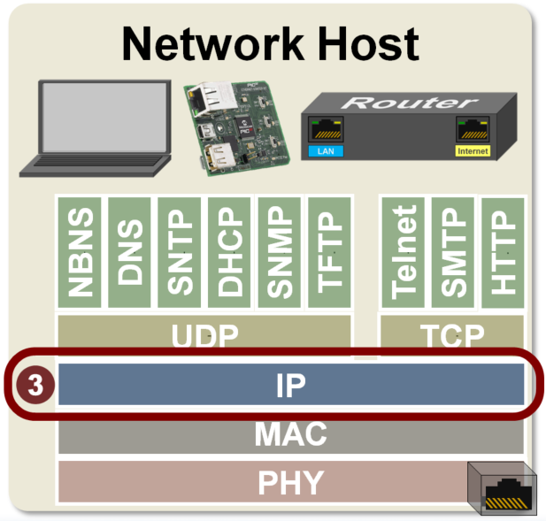
IP

Slide 34
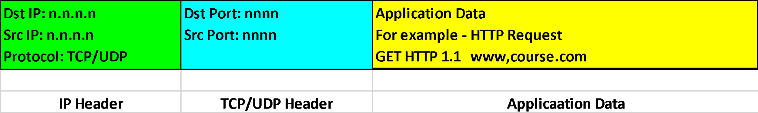
Internetwork-Layer Protocols
The Internetwork layer is where administrators usually do the most network configuration
Where the IP protocol operates and is the heart of the TCP/IP protocol suite
Responsible for four main tasks:
Defines and verifies IP addresses
Routes packets through an internetwork
Resolves MAC addresses from IP addresses
Delivers packets efficiently

Slide 35
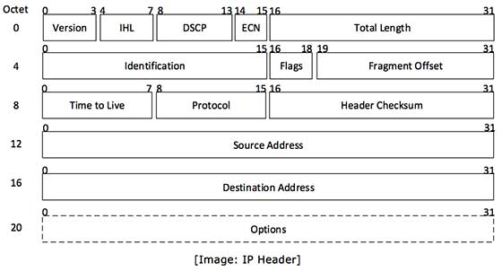
IP Header
Source: https://www.tutorialspoint.com/ipv4/ipv4_packet_structure.htm
Notes:
IP header includes many relevant information including Version Number, which, in this context, is 4. Other details are as follows:
Version: Version no. of Internet Protocol used (e.g. IPv4).
IHL: Internet Header Length; Length of entire IP header.
DSCP: Differentiated Services Code Point; this is Type of Service.
ECN: Explicit Congestion Notification; It carries information about the congestion seen in the route.
Total Length: Length of entire IP Packet (including IP header and IP Payload).
Identification: If IP packet is fragmented during the transmission, all the fragments contain same identification number. to identify original IP packet they belong to.
Flags: As required by the network resources, if IP Packet is too large to handle, these ‘flags’ tells if they can be fragmented or not. In this 3-bit flag, the MSB is always set to ‘0’.
Fragment Offset: This offset tells the exact position of the fragment in the original IP Packet.
Time to Live: To avoid looping in the network, every packet is sent with some TTL value set, which tells the network how many routers (hops) this packet can cross. At each hop, its value is decremented by one and when the value reaches zero, the packet is discarded.
Protocol: Tells the Network layer at the destination host, to which Protocol this packet belongs to, i.e. the next level Protocol. For example protocol number of ICMP is 1, TCP is 6 and UDP is 17.
Header Checksum: This field is used to keep checksum value of entire header which is then used to check if the packet is received error-free.
Source Address: 32-bit address of the Sender (or source) of the packet.
Destination Address: 32-bit address of the Receiver (or destination) of the packet.
Options: This is optional field, which is used if the value of IHL is greater than 5. These options may contain values for options such as Security, Record Route, Time Stamp, etc.

Slide 36
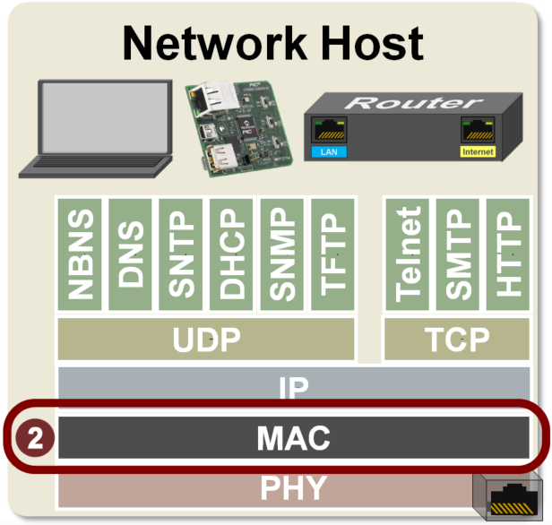
Data link layer(Network access)
Layer 2 is the Data Link layer. This layer uses a Media Access Controller (MAC) to generate the frames that will be transmitted. As the name suggests, the MAC controls the physical transmission media.
When transmitting data, this layer adds a header containing the source and destination MAC addresses to the packet received from the Network layer (layer 3). The frame it creates will then be forwarded to the Physical layer.

Slide 37
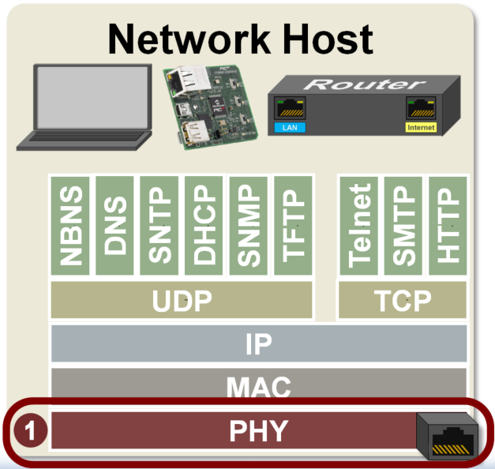
Physical Layer
Layer 1 is the Physical layer. It sends and receives signals on the physical wire or antenna to transmit the bits found in frames.
There is a PHY found at the end of every network interface (e.g. end of wire or antenna).

Slide 38
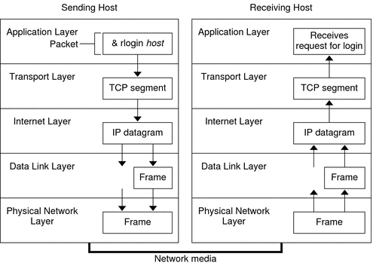
Data Encapsulation
When a protocol on the sending system adds data to the packet header, the process is called data encapsulation.
source: https://docs.oracle.com/cd/E19120-01/open.solaris/819-3000/ipov-32/index.html
Notes:
This section summarizes the life cycle of a packet. The life cycle starts when you issue a command or send a message. The life cycle finishes when the appropriate application on the receiving system receives the packet.
Application Layer: Where a Communication Originates
The packet's history begins when a user on one system sends a message or issues a command that must access a remote system. The application protocol formats the packet so that the appropriate transport layer protocol, TCP or UDP, can handle the packet.
Suppose the user issues an rlogin command to log in to the remote system, as shown in Figure 1–1. The rlogin command uses the TCP transport layer protocol. TCP expects to receive data in the form of a stream of bytes that contain the information in the command. Therefore, rlogin sends this data as a TCP stream.
Transport Layer: Where Data Encapsulation Begins
When the data arrives at the transport layer, the protocols at the layer start the process of data encapsulation. The transport layer encapsulates the application data into transport protocol data units.
The transport layer protocol creates a virtual flow of data between the sending and receiving application, differentiated by the transport port number. The port number identifies a port, a dedicated location in memory for receiving or sending data. In addition, the transport protocol layer might provide other services, such as reliable, in order data delivery. The end result depends on whether TCP, SCTP, or UDP handles the information.
TCP Segmentation
TCP is often called a “connection-oriented” protocol because TCP ensures the successful delivery of data to the receiving host. Figure 1–1 shows how the TCP protocol receives the stream from the rlogin command. TCP then divides the data that is received from the application layer into segments and attaches a header to each segment.
Segment headers contain sending and receiving ports, segment ordering information, and a data field that is known as a checksum. The TCP protocols on both hosts use the checksum data to determine if the data transfers without error.
Establishing a TCP Connection
TCP uses segments to determine whether the receiving system is ready to receive the data. When the sending TCP wants to establish connections, TCP sends a segment that is called a SYN to the TCP protocol on the receiving host. The receiving TCP returns a segment that is called an ACK to acknowledge the successful receipt of the segment. The sending TCP sends another ACK segment, then proceeds to send the data. This exchange of control information is referred to as a three-way handshake.
UDP Packets
UDP is a “connectionless” protocol. Unlike TCP, UDP does not check that data arrived at the receiving host. Instead, UDP formats the message that is received from the application layer into UDP packets. UDP attaches a header to each packet. The header contains the sending and receiving ports, a field with the length of the packet, and a checksum.
The sending UDP process attempts to send the packet to its peer UDP process on the receiving host. The application layer determines whether the receiving UDP process acknowledges the reception of the packet. UDP requires no notification of receipt. UDP does not use the three-way handshake.
Internet Layer: Where Packets Are Prepared for Delivery
The transport protocols TCP, UDP, and SCTP pass their segments and packets down to the Internet layer, where the IP protocol handles the segments and packets. IP prepares them for delivery by formatting them into units called IP datagrams. IP then determines the IP addresses for the datagrams, so that they can be delivered effectively to the receiving host.
IP Datagrams
IP attaches an IP header to the segment or packet's header, in addition to the information that is added by TCP or UDP. Information in the IP header includes the IP addresses of the sending and receiving hosts, the datagram length, and the datagram sequence order. This information is provided if the datagram exceeds the allowable byte size for network packets and must be fragmented.
Data-Link Layer: Where Framing Takes Place
Data-link layer protocols, such as PPP, format the IP datagram into a frame. These protocols attach a third header and a footer to “frame” the datagram. The frame header includes a cyclic redundancy check (CRC) field that checks for errors as the frame travels over the network media. Then, the data-link layer passes the frame to the physical layer.
Physical Network Layer: Where Frames Are Sent and Received
The physical network layer on the sending host receives the frames and converts the IP addresses into the hardware addresses appropriate to the network media. The physical network layer then sends the frame out over the network media.
How the Receiving Host Handles the Packet
When the packet arrives on the receiving host, the packet travels through the TCP/IP protocol stack in the reverse order from which it was sent. Figure 1–1 illustrates this path. Moreover, each protocol on the receiving host strips off header information that is attached to the packet by its peer on the sending host. The following process occurs:
The physical network layer receives the packet in its frame form. The physical network layer computes the CRC of the packet, then sends the frame to the data link layer.
The data-link layer verifies that the CRC for the frame is correct and strips off the frame header and the CRC. Finally, the data-link protocol sends the frame to the Internet layer.
The Internet layer reads information in the header to identify the transmission. Then, the Internet layer determines if the packet is a fragment. If the transmission is fragmented, IP reassembles the fragments into the original datagram. IP then strips off the IP header and passes the datagram on to transport layer protocols.
The transport layer (TCP, SCTP, and UDP) reads the header to determine which application layer protocol must receive the data. Then, TCP, SCTP, or UDP strips off its related header. TCP, SCTP, or UDP sends the message or stream to the receiving application.
The application layer receives the message. The application layer then performs the operation that the sending host requested.

Slide 39
Summary
TCP/IP is the main protocol suite used in networks
The Application layer consists of protocols such as HTTP and DNS and provides an interface for applications to access network services
The Transport layer provides reliability and works with segments (TCP) and datagrams (UDP)
The Internetwork layer is where most network configuration occurs and is composed of IP, ICMP, and ARP

Slide 40
Summary
The Network access layer is composed of network technologies, such as Ethernet and WAN technologies

Slide 41
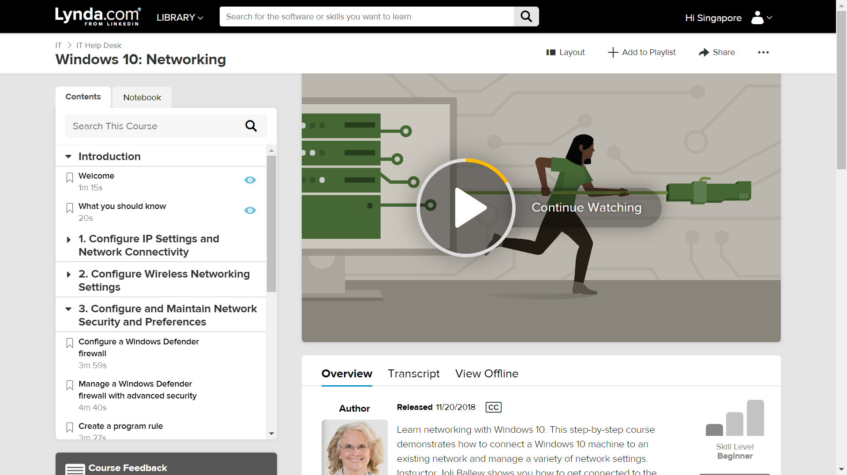

Slide 42
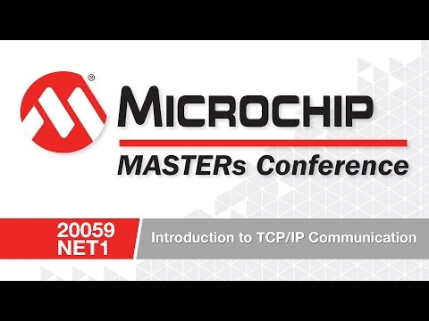
Learn More: Introduction to TCP/IP Video

